Slide 1
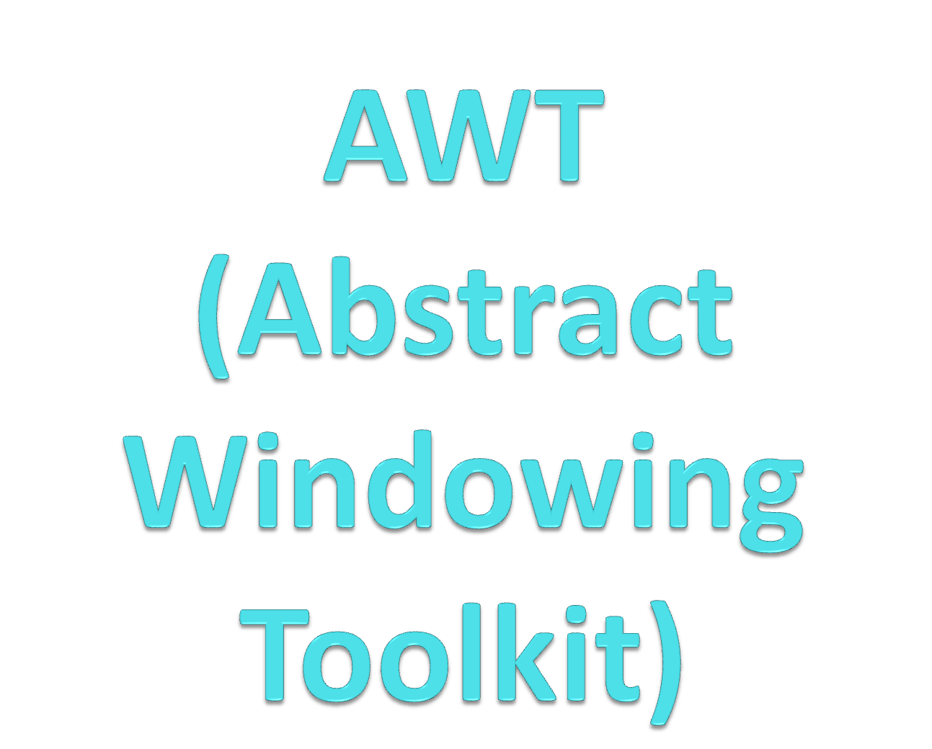

Slide 2
AWT
Absract window toolkit: is a set of Application Program Interface(API) used by java to create and interact with GUI objects such as buttons,scroll bar and windows.
Java AWT components are platform-dependent i.e. components are displayed according to the view of operating system
It has heavy weight i.e. Uses resources of OS

Slide 3
AWT is divided into 3 categories
Containers
Components
Layout Managers.

Slide 4
Using AWT Components
Component
  Canvas
  Scrollbar
  Button
  Checkbox
  Label
  List
  Choice
  TextComponent
      TextArea
      TextField
Container
    Panel
    Window
      Dialog
        FileDialog
      Frame
MenuComponent
  MenuItem
    Menu

Slide 5
Hierarchy of AWT classes
Object
Component
Canvas
Label
Container
TextField
TextArea
List
Button
Scrollbar
Panel
Window
TextComponent
Checkbox
Applet
Frame
Choice

Slide 6

Frame ScrollPane
Panel
Window
Applet
Dialog

Slide 7
Container
public class Container extends Component
Container is a subclass of Component. (ie. All containers are themselves, Components)
A container object is a component that can contain other AWT components.
For a component to be placed on the screen, it must be placed within a Container
Containers are Frame, Panel, Dialog, ScrollPane, Window and Applet

Slide 8

The Container class defines the set of methods necessary for managing groups of Components
  add
  getComponent
  getMaximumSize
  getMinimumSize
  getPreferredSize
  remove
  removeAll
  setSize
  setLocation
  setVisible
  setLayout

Slide 9
Frame
A Frame is a top-level window with a title and a border
It is the one of the container to put all the components.
Frame is a class defined in java.awt package.
Frame class has two Constructors
  public Frame()
  public Frame(String title) //to give name to frame
Constructs a new, invisible(By default) Frame object with the specified title.
Methods of Frame class:
  public String getTitle()//to get the name of frame in a string
  public void setTitle(String title)//to give name to frame through method

Slide 10
2 ways to create a Frame container
Frame creation using inheritence.
Frame creation using Association (through object making of Frame class)

Slide 11
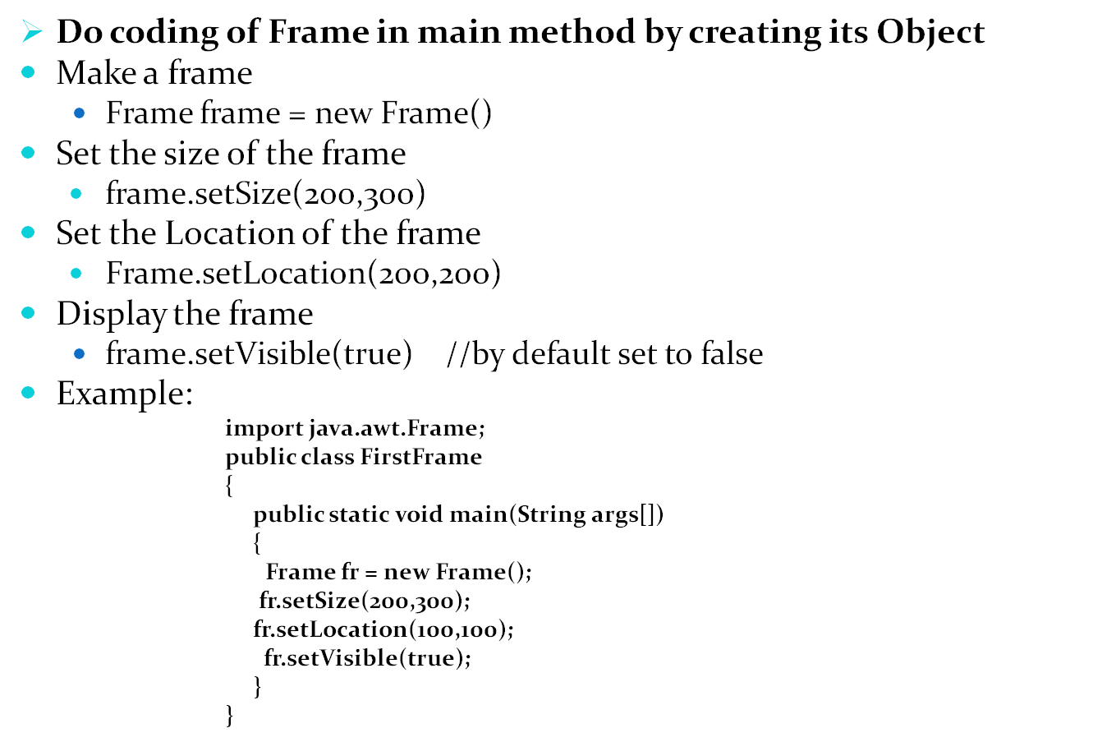
Programme to make Container (Frame) throughAssociation

Slide 12
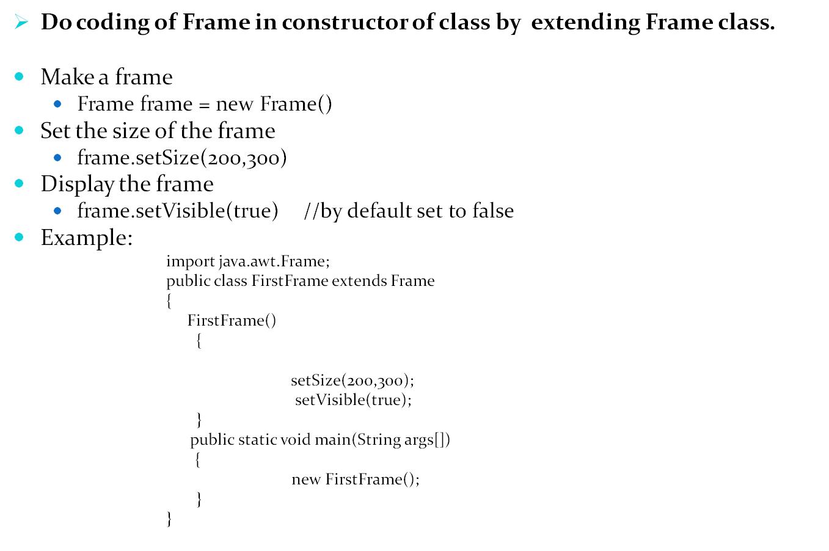
Programme to make Container (Frame) through Inheritence

Slide 13
Tasks to perform on the Frame
Change the background color of Frame ?
Add a title to the Frame (through constructor as well as through method) ?
Set its Location over the screen ?
Set its Size with respect to screensize. (pixel measure) ?
Make the Frame visible over the screen ?
Implement setBounds(x,y,w,h) method ?
Can we place one frame over another frame ?

Slide 14

Button TextField Scrollbar
Label TextArea Menu
Checkbox List
CheckboxGroup Choice

Slide 15
Components
A component is an object having a graphical representation that can be displayed on the screen and that can interact with the user.
Component is the superclass of most of the displayable classes defined within the AWT
Examples of components are the buttons, checkboxes, and scrollbars of a typical graphical user interface.
The Component class is the abstract superclass of the non-menu-related components.

Slide 16
MenuComponent is another class which is similar to Component except it is the superclass for all GUI items which can be displayed within a drop-down menu.
The Component class has predefined set of methods which are relevant to all Components
  setBounds
  setSize
  setLocation
  setFont
  setEnabled
  setVisible
  setForeground -- colour
  setBackground -- colour

Slide 17
Button component
Button is an active component which is used to perform some operations such as saving the details into the database, deleting the details from the database, etc.
Creating a button is nothing but creating an object of Button class.
Button is a control component that has a label and generates an event when pressed.
Button class has two Constructors
  public Button()
  public Button(String title) //to give name to button
Constructs a new, button object with the specified string title .

Slide 18
Methods of Frame class:
  public String getLabel()//to get the name of Button in a string
  public void setLabel(String title)//to give name to frame through method

Slide 19
Add Button over the frame
import java.awt.Frame;
import java.awt.Button;
public class FrameWithButton
{
public static void main(String[] args)
{
Frame fr = new Frame();
fr.setBounds(200,300,500,500);
fr.setBackground(Color.RED);
fr.setVisible(true);
Button btn = new Button();
fr.add(btn);
}
Note: The button will fill all the available space in the frame.

Slide 20
Set position of control
Position can be specified in two ways:
  1) By using LayoutManagers
  2) Absolute positions
Specifying the absolute position of a control
  Set the LayoutManager to null.
    setLayout(null)
  Set Size :
    setSize(int width, int height)
  Set Location:
    setLocation(int x, int y)
  The top-left corner of the new location is specified by the “x” and “y”
  You can also use setBounds(x,y,w,h); method to collectively do the work of setSize(x,y) and setLocation(w,h);
  If you do not set the LayoutManager to null then ,it will not allow you to specify the size and location

Slide 21
import java.awt.Frame;
import java.awt.Button;
public class FrameWithButton
{
public static void main(String[] args)
{
Frame fr = new Frame(“first frame”);
fr.setBounds(200,300,500,500);
fr.setBackground(Color.RED);
fr.setVisible(true);
Button btn = new Button(“button 1”);
fr.add(btn);
fr.setLayout(null);
  btn.setSize(int x, int y);
  btn.setLocation(int x, int y) ;
}

Slide 22
Practice to perform on the Button
Change the background color of Button
Provide a name to the Button (through constructor as well as through method)
Set its Location over the screen
Set its Size with respect to screensize. (pixel measure)
Implement setBounds(x,y,w,h) method
Make the button invisible over the screen.

Slide 23
Label Component
The object of Label class is a component for placing text in a container. A label displays a single line of read-only text.
The text can be changed by the application programmer but cannot be changed by the end user in any way.
Label has following constructor:
  Label()Constructs an empty label.
  Label(String text) Constructs a new label with the specified string of text, left justified.
  Label(String text, int alignment)Constructs a new label that presents the specified string of text with the specified alignment. As CENTER ,LEFT , RIGHT

Slide 24
Methods of Label class:
setAlignment(int )
setText(String str);
String getText();

Slide 25
Add Label over the Frame
Create object of class Label
Label lbl = new Label("This is a Label");
Set size and location
lbl.setSize(100,20);
lbl.setLocation(50,50);
Add to frame
fr.add(lbl);

Slide 26
Checkbox component
Checkbox control is used to turn an option on(true) or off(false). There is label for each checkbox representing what the checkbox does.The state of a checkbox can be changed by clicking on it.
Checkbox class has set of constructors:
  Checkbox():Creates a check box with an empty string for its label.
  Checkbox(String label):Creates a check box with the specified label.
  Checkbox(String label, boolean state)Creates a check box with the specified label and sets the specified state.

Slide 27
Methods of Checkbox class
Strng getLAbel();
Boolean getState();
setLabel( String str);
setState(Boolean b);

Slide 28
Add Checkbox
Create object of Checkbox class
Checkbox cb = new Checkbox();
Set the label for checkbox
cb.setLabel("CheckBox1");
Set size and location
cb.setSize(10,10);
cb.setLocation(50,80);
Add to frame
fr.add(cb);

Slide 29
radiobutton Componnet
In java.awt we are not having a special class for radio buttons but we can create radio button from Checkbox class.
java.awt we have a predefined class called CheckboxGroup through which we can add all the checkboxes to the object of CheckboxGroup class.
Constructor of radiobutton :
  Checkbox(String label, boolean state, CheckboxGroup group)
Constructs a Checkbox with the specified label, set to the specified state, and in the specified check box group.
  Checkbox(String label, CheckboxGroup group, boolean state)
Creates a check box with the specified label, in the specified check box group, and set to the specified state.

Slide 30
Add Radio button
CheckboxGroup group = new CheckboxGroup();
Checkbox cb1 = new Checkbox("CheckBox1", true, group);
cb1.setSize(100,20);
cb1.setLocation(50,170);
Checkbox cb2 = new Checkbox("CheckBox2", group, false);
cb2.setSize(100,20);
cb2.setLocation(50,190);
fr.add(cb1);
fr.add(cb2);

Slide 31
TextField component
The object of a TextField class is a text component that allows the editing of a single line text. It inherits TextComponent class.
Constructor of TextField class are:
  TextField() :Constructs a new text field.
  TextField(int columns) :Constructs a new empty text field with the specified number of columns.
  TextField(String text) :Constructs a new text field initialized with the specified text.
  TextField(String text, int columns):Constructs a new text field initialized with the specified text to be displayed, and wide enough to hold the specified number of columns.

Slide 32
Methods of TextField class are:
setText(String str);
String getText();

Slide 33
TextArea Component
The object of a TextArea class is a multi line region that displays text. It allows the editing of multiple line text.
Constructor of TextArea Class are:
TextArea():Constructs a new text area with the empty string as text.
TextArea(int rows, int columns)Constructs a new text area with the specified number of rows and columns and the empty string as text.
TextArea(String text):Constructs a new text area with the specified text.
TextArea(String text, int rows, int columns): Constructs a new text area with the specified text, and with the specified number of rows and columns.
TextArea(String text, int rows, int columns, int scrollbars) :Constructs a new text area with the specified text, and with the rows, columns, and scroll bar visibility as specified.

Slide 34
Methods of TextArea class
  setText(String str);
  String getText ();
  Fields of TextArea are :
static int SCROLLBARS_BOTH -- Create and display both vertical and horizontal scrollbars.
static int SCROLLBARS_HORIZONTAL_ONLY -- Create and display horizontal scrollbar only.
static int SCROLLBARS_NONE -- Do not create or display any scrollbars for the text area.
static int SCROLLBARS_VERTICAL_ONLY -- Create and display vertical scrollbar only.

Slide 35
Components which holds multiple items
Choice
List
Menu
Scrollbar
TextArea

Slide 36
Choice Component
The object of Choice class is used to show popup menu of choices. Choice selected by user is shown on the top of a menu.
Constructor of Choice:
Choice(): empty constructor
Methods of Choice class:
Add(String str);
Int countItems();
String getItem(int index);
insert(String item, int index);
remove(int index);
remove(String item);

Slide 37
Add Choice
Create object of class Choice
  Choice ch= new Choice ();
Insert items to dropdown
  public void insert(String item, int index)
  ch.add (“Red”);
  ch.add(“Blue”);
Add to frame
fr.add(ch);

Slide 38
List Component
The object of List class represents a list of text items. By the help of list, user can choose either one item or multiple items.
Constructor of List class:
List():Creates a new scrolling list.
List(int rows):Creates a new scrolling list initialized with the specified number of visible lines.
List(int rows, boolean multipleMode):
Creates a new scrolling list initialized to display the specified number of rows.

Slide 39
Methods of List class:
Add(String str);
Int countItems();
String getItem(int index);
add(String item, int index);
remove(int index);
remove(String item);

Slide 40
Add List
Create object of class Choice
  List l= new List ();
Insert items to dropdown
  public void insert(String item, int index)
  l.add (“Red”);
  l.add(“Blue”);
Add to frame
fr.add(l);

Slide 41
Scrollbar component
The object of Scrollbar class is used to add horizontal and vertical scrollbar. Scrollbar is a GUI component allows us to see invisible number of rows and columns.
Constructor of Scrollbar are:
  Scrollbar() :Constructs a new vertical scroll bar.
  Scrollbar(int orientation):Constructs a new scroll bar with the specified orientation.
  Scrollbar(int orientation, int value, int visible, int minimum, int maximum):Constructs a new scroll bar with the specified orientation, initial value, visible amount, and minimum and maximum values.

Slide 42
Add Scrollbar
Create an object of Scrollbar class
Scrollbar s=new Scrollbar();
Set its size and locatio
s.setBounds(100,100, 50,100);
Add it over the frame
f.add(s);

Slide 43
Menu Component
The Menu class represents pull-down menu component which is deployed from a menu bar.
Constructors of Menu class are:
Menu() :Constructs a new menu with an empty label.
Menu(String label):Constructs a new menu with the specified label.
Menu(String label, boolean tearOff):Constructs a new menu with the specified label, indicating whether the menu can be torn off.

Slide 44
Methods of Menu class
MenuItem add(MenuItem mi)
void add(String label)
void remove(int index)
    remove(MenuComponent item)
  removeAll()

Slide 45
Add Menu
MenuBar mb=new MenuBar();
Menu menu=new Menu("Menu");
Menu submenu=new Menu("Sub Menu");
MenuItem i1=new MenuItem("Item 1");
MenuItem i2=new MenuItem("Item 2");
MenuItem i3=new MenuItem("Item 3");
MenuItem i4=new MenuItem("Item 4");
MenuItem i5=new MenuItem("Item 5");
menu.add(i1);
menu.add(i2);
menu.add(i3);
submenu.add(i4);
submenu.add(i5);
menu.add(submenu);
mb.add(menu);
f.setMenuBar(mb);

Slide 46
Thank You

